Slide 1
CS 3006 Parallel and Distributed Computing Lecture 26
Danyal Farhat
FAST School of Computing
NUCES Lahore

Slide 2
Distributed File System

Slide 3
Outline
File System
Distributed File System
Distributed File Service Architecture
Client Module
Directory Service
Flat file Service
Distributed File System Examples
NFS Architecture
Hierarchic File System
Mount Service

Slide 4
File System
File system were originally developed for centralized computer systems and desktop computers
File system was as an operating system facility providing a convenient programming interface to disk storage
File systems are responsible for the organization, storage, retrieval, naming, sharing and protection of files
Files contain both data and attributes

Slide 5
Distributed File System
Distributed file systems support the sharing of information in the form of files and hardware resources
A DFS enables programs to store and access remote files /storage exactly as local ones
The performance and reliability of such access should be comparable to that for files stored locally

Slide 6
Distributed File System (Cont.)
Recent advances in higher bandwidth connectivity of switched local networks and disk organization have lead high performance and highly scalable file systems
Functional requirements: open, close, read, write, access control, directory organization, ..
Non-functional requirements: scalable, fault-tolerant, secure

Slide 7
Distributed File Service Architecture
An architecture that offers a clear separation of the main concerns in providing access to files is obtained by structuring the file service as three components:
A flat file service
A directory service
A client module
Client computer
Server computer
Application
Application
Directory service
program
program
Flat file service
Client module

Slide 8
Distributed File Service Architecture (Cont.)
The Client module implements exported interfaces of flat file and directory services available on server side
Responsibilities of various modules can be defined as follows:
Client Module
It runs on each computer and provides integrated service (flat file and directory) as a single API to application programs. For example, in UNIX hosts, a client module emulates the full set of Unix file operations.
It holds information about the network locations of flat-file and directory server processes; and achieve better performance through implementation of a cache of recently used file blocks at the client.

Slide 9
Distributed File Service Architecture (Cont.)
Directory Service
Provides mapping between text names for the files and their Unique File identifiers (UFIDs)
Clients may obtain the UFID of a file by quoting its text name to directory service
Directory service supports functions needed to generate directories and to add new files to directories
/var/log/syslog
Flat File Service
Concerned with the implementation of operations on the contents of file
Unique File Identifiers (UFIDs) are used to refer to files in all requests for flat file service operations
UFIDs are long sequences of bits chosen so that each file has a unique among all of the files in a distributed system

Slide 10
Distributed File Service Architecture (Cont.)
Create file operation
Read / write file operation
Delete file operation
Client computer
Server computer
Application
Application
Directory service
program
program
Flat file service
Client module

Slide 11
Distributed File System Examples
Network File System (NFS)
Andrew File System (AFS)
Hadoop Distributed File System (HDFS)

Slide 12
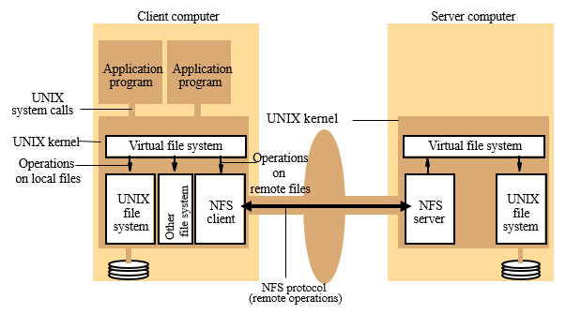
NFS Architecture

Slide 13
NFS Architecture (Cont.)
The NFS client and server modules communicate using Remote Procedure Calls
Sun’s RPC system
Sun RPC was developed for use in NFS. It can be configured to use either UDP or TCP, and the NFS protocol is compatible with both

Slide 14
Hierarchic File System
A hierarchic file system consists of a number of directories arranged in a tree structure
Any file or directory can be referenced using a pathname – a multi-part name
A UNIX-like file-naming system can be implemented by the client module using the flat file and directory services that we have defined.
A tree-structured network of directories is constructed with files at the leaves and directories at the other nodes of the tree.
The root of the tree is a directory with a ‘well-known’ UFID.
A function can be provided in the client module that gets the UFID of a file given its pathname. The function interprets the pathname.
Pathname starting from the root, using Lookup to obtain the UFID of each directory in the path

Slide 15
Mount Service
The mounting of subtrees of remote file systems by clients is supported by a separate mount service process that runs at user level on each NFS server computer.
On each server, there is a file with a well-known name (/etc/exports) containing the names of local file systems that are available for remote mounting.
An access list is associated with each file system name indicating which hosts are permitted to mount the file system
Mount operation:
mount(remotehost, remotedirectory, localdirectory)
Each client maintains a table of mounted file systems holding: < IP address, port number, file handle>

Slide 16
Mount Service (Cont.)
The file system mounted at /usr/students in the client is actually the sub-tree located at /export/people in Server 1
The file system mounted at /usr/staff in the client is actually the sub-tree located at /nfs/users in Server 2

Slide 17
Summary
File System
OS facility that provides a convenient programming interface to disk storage
Distributed File System
Support sharing of information in the form of files and hardware resources
Distributed File Service Architecture
Client Module
Directory Service
Flat File Service
Distributed File System Examples
NFS, AFS, HDFS

Slide 18
Summary (Cont.)
NFS Architecture
NFS client and server modules communicate using Remote Procedure Calls
Hierarchic File System
Consists of a number of directories arranged in a tree structure
Mount Service
mount(remotehost, remotedirectory, localdirectory)

Slide 19
Questions?

